Slide 1
Beer Judge
There is no accounting for taste

Slide 2
A drinking problem
The craft beer industry in the United States and Canada has exploded in the past 5 years.
There are now 167 craft breweries in Ontario, each producing dozens of beers.
There are simply too many beers for a human to process.
Unless you have an unlimited budget and an iron liver.
We need a beer recommendation engine!

Slide 3
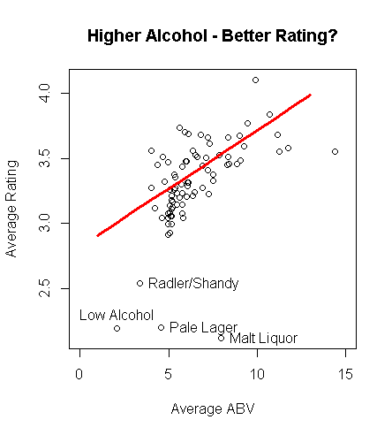
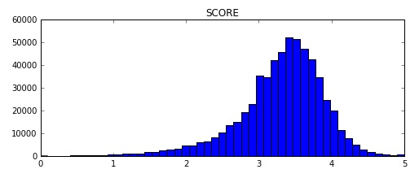
A million bottles of beer on the wall
620,000 reviews
4000 users
98,000 unique words
23 fields
Mean score 3.3, std dev 0.33
Long tailed
Similar distribution for other metrics

Slide 4
Potent(ial) Solutions
Text Based Feature Extraction
Latent Dirichlet Allocation (LDA)
Comparison Methods
Naïve Bayes and Probability Distributions
Netflix Prize and Collaborative Filtering
Alternating Least Squares Matrix Factorization (ALS)

Slide 5
5 step program
Use import.io to scrape 620,000 beer reviews from RateBeer.com
72 full hours of scraping
Python to parse data
Spark + Python = PySpark for modelling
Mllib, SciPy, NLTK, NumPy, matplotlib, Flask
TF-IDF cosine similarity, Naïve Bayes, ALS collaborative filter
Create a MySQL database
Users, Beers, Reviews, Styles, Breweries
Flask and cherryPy webserver

Slide 6
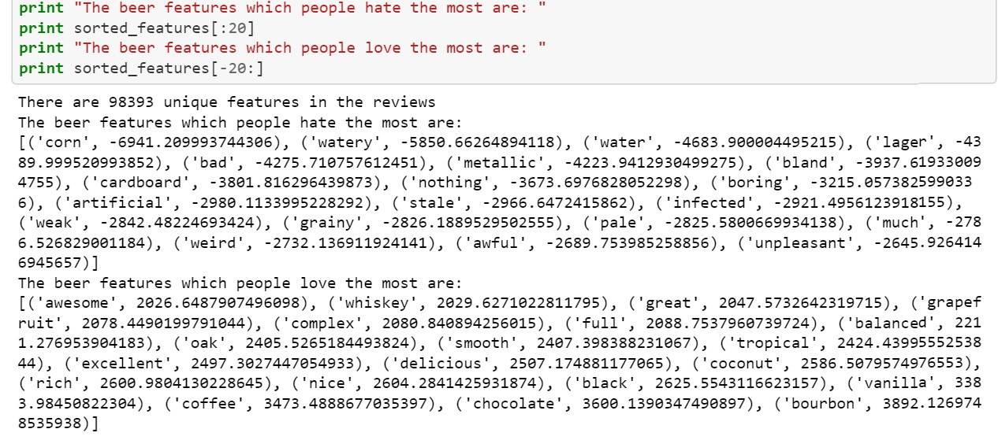
Slurring your words
TF-IDF for feature extraction
Weight TF-IDF by the score
Reduce across all users and reviews

Slide 7

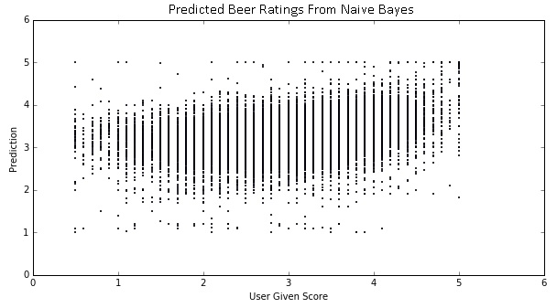
Rating the Tap List
Spearman correlation
Cosine Similarity on TF-IDF features
Spearman 0.171
Naïve Bayes on reduced feature set
Spearman 0.176
MSE 0.277 – RMSE 0.526
Average 26 words per review

Slide 8
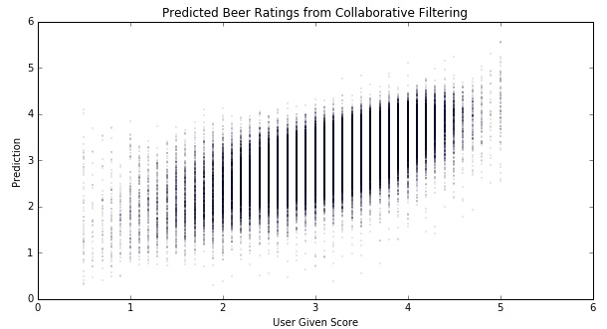
Drinking Buddies
Collaborative Filtering
Spearman 0.516 for all the beers in the test set
The MSE is 0.209, corresponding to an RMSE of 0.45.
Also the mean error is 0.16
Hardware
Need a Spark Cluster

Slide 9
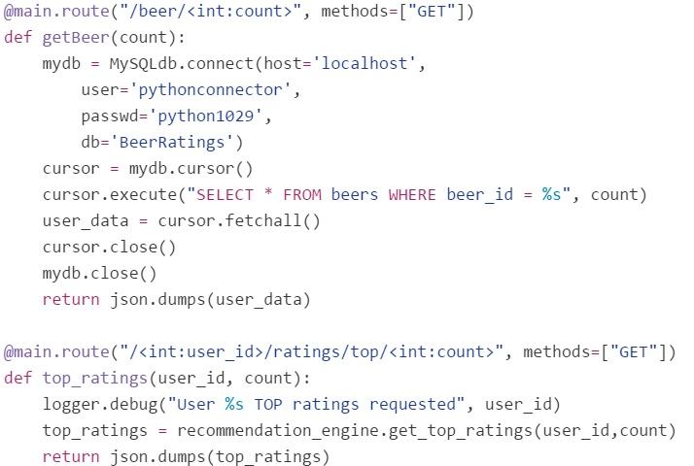
Drinking it all in
Flask and cherryPy
Lightweight webservers
ALS is the clear winner
Feature Extraction
Ranking is a difficult task
Team Python

